Slide 1
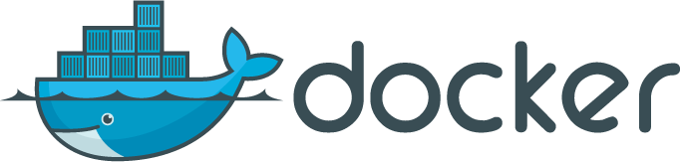
Compose, Machine and Swarm

Slide 2
Compose
One binary to start/manage multiple containers and volumes on a single Docker host
Originated from Fig
Move your lengthy docker run
commands to a YAML file

Slide 3
Installation
Via pip
Or just get the binary
$ sudo curl -L https://github.com/docker/compose/releases/download/1.1.0/ docker-compose-`uname -s`-`uname -m` > /usr/local/bin/docker- compose

Slide 4
Use
$ docker-compose up -d Creating vagrant_mysql_1...
Creating vagrant_wordpress_1...
$ docker-compose ps
Name Command
Ports
State
vagrant_mysql_1 3306/tcp | /entrypoint.sh | mysqld | Up
vagrant_wordpress_1 0.0.0.0:80->80/tcp | /entrypoint.sh | apache2-for ... | Up

Slide 5
YAML description
wordpress:
image: wordpress links:
mysql ports:
- "80:80"
environment:
WORDPRESS_DB_NAME=wordpress
WORDPRESS_DB_USER=wordpress
WORDPRESS_DB_PASSWORD=wordpresspwd mysql:
image: mysql volumes:
/home/docker/mysql:/var/lib/mysql environment:
MYSQL_ROOT_PASSWORD=wordpressdocker
MYSQL_DATABASE=wordpress
MYSQL_USER=wordpress
MYSQL_PASSWORD=wordpresspwd

Slide 6
Machine
One binary to create a remote Docker host and setup the TLS communication with your local docker client.
Automates the TLS setup and the configuration of the local environment
Can manage multiple machines in different clouds at the same time

Slide 7
Installation (e.g OSX)
$ wget https://github.com/docker/machine/releases/download/v0.1.0/docker
-machine_darwin-amd64
$ mv docker-machine_darwin-amd64 docker-machine
$ chmod +x docker-machine
$ ./docker-machine --version docker-machine version 0.1.0

Slide 8
Local Use
$ docker-machine ls
NAME ACTIVE
dev *
DRIVER
virtualbox
STATE URL SWARM
Running tcp://192.168.99.100:2376
$ docker-machine env dev export DOCKER_TLS_VERIFY=1 export
DOCKER_CERT_PATH=/Users/sebastiengoasguen/.docker/machine/machine s/dev
export DOCKER_HOST=tcp://192.168.99.100:2376
$ docker images REPOSITORY
TAG
… CREATED
VIRTUAL SIZE
wordpress | latest | … | 2 | weeks | ago | 451.4 | MB
mysql | latest | … | 2 | weeks | ago | 282.8 | MB
mysql | 5.5 | … | 2 | weeks | ago | 214.5 | MB

Slide 9
Cloud Use
Many drivers
Many more waiting for merge (i.e cloudstack )
$ ./docker-machine create -d digitalocean foobar INFO[0000] Creating SSH key...
INFO[0001] Creating Digital Ocean droplet... INFO[0005] Waiting for SSH...
INFO[0072] Configuring Machine...

Slide 10
Swarm
•
Docker client endpoint that proxies requests to docker daemons running in a cluster.
•
Cluster manager that keeps state of the cluster nodes
•
Easily run as a container itself
•
Multiple service discoveries for cluster nodes (docker hosted, etcd, consul, zookeeper, file based)

Slide 11
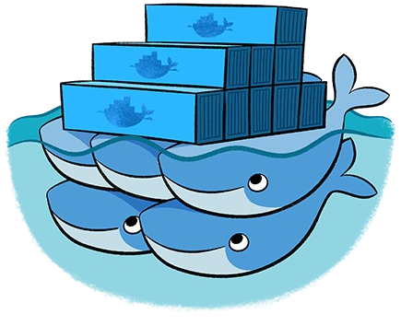
Swarm

Slide 12
Use
No install, run the container
docker pull swarm
$ docker run -v /vagrant:/tmp/vagrant -p 1234:1234 -d swarm manage file://tmp/vagrant/swarm-cluster.cfg -H=0.0.0.0:1234
72acd5bc00de0b411f025ef6f297353a1869a3cc8c36d687e1f28a2d8f422a06
$ docker -H 0.0.0.0:1234 info Containers: 0
Nodes: 3
swarm-2: 192.168.33.12:2375
└ Containers: 0
└ Reserved CPUs: 0 / 1
└ Reserved Memory: 0 B / 490 MiB
…
$ docker -H 0.0.0.0:1234 run -d -p 80:80 nginx

Slide 13
Use Machine to create Swarm
Get a token for discovery
Start nodes with machine using the --swarm
option
$ docker run swarm create 31e61710169a7d3568502b0e9fb09d66
$ docker-machine create -d virtualbox --swarm --swarm-master
--swarm-discovery token://31e61710169a7d3568502b0e9fb09d66 head
...
$ docker-machine create -d digitalocean --swarm --swarm-discovery token://31e61710169a7d3568502b0e9fb09d66 worker-00
...
$ docker-machine create -d azure --swarm --swarm-discovery token://31e61710169a7d3568502b0e9fb09d66 swarm-worker-01

Slide 14
Links
Check:
https://github.com/how2dock/docbook
Lots of Vagrantfiles and scripts to test these features
Docs:
http://docs.docker.com
https://github.com/docker/<compose,machine,s warm>

Slide 15
Conclusions
Three new Docker features to simplify:
provisioning of Docker hosts locally and in the Cloud
Management of groups of containers started on a host
Creation of cluster of Docker host and scheduling of containers in them
Merge of the three to provide “batteries included” experience will be great.
Concerns on scheduling do-over for the cluster management, fault-tolerance, scaling, etc

Slide 16
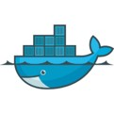
What is Docker ?
Docker is an open platform for developing, shipping, and running applications.
Docker provides a way to run almost any application securely isolated in a container.
The isolation and security allow you to run many containers simultaneously on your host.
The lightweight nature of containers, which run without the extra load of a hypervisor, means you can get more out of your hardware.

Slide 17
Docker Components
Docker: the open source container virtualization platform
Docker Hub: SaaS platform for sharing and managing Docker images
Docker Daemon runs on a host machine and does the heavy lifting of building, running, and distributing Docker containers.
Docker client is a Docker binary that accepts commands from the user and communicates back and forth with daemon.

Slide 18
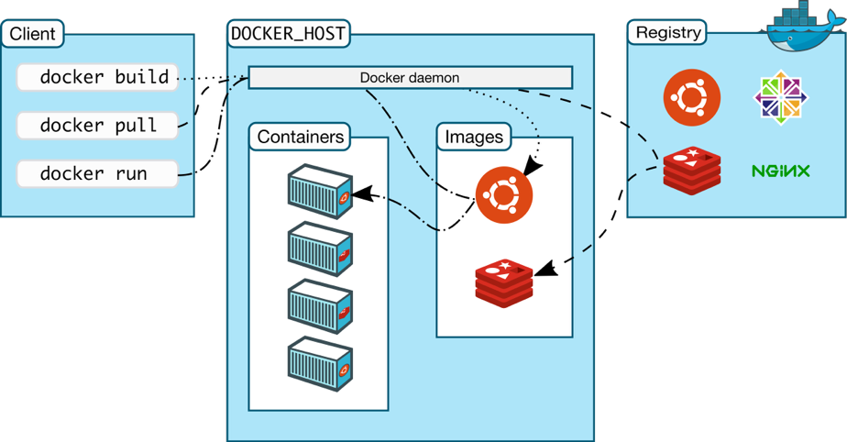
How does it work ?

Slide 19
Docker Demo
Create docker-machine
Pull an image Create a Container Start a container
Stop and Remove a container

Slide 20
Docker Compose
Compose is a tool for defining and running complex applications with Docker.
With Compose, you define a multi-container application in a single file, then spin your application up in a single command which does everything that needs to be done to get it running.
Compose is great for development, testing, and staging environments, as well as CI workflows.

Slide 21
How to use Docker Compose ?
Define your app’s environment with a Dockerfile so it can be reproduced anywhere.
Define the services that make up your app in docker- compose.yml so they can be run together in an isolated environment.
Lastly, run docker-compose up and Compose will start and run your entire app.

Slide 22
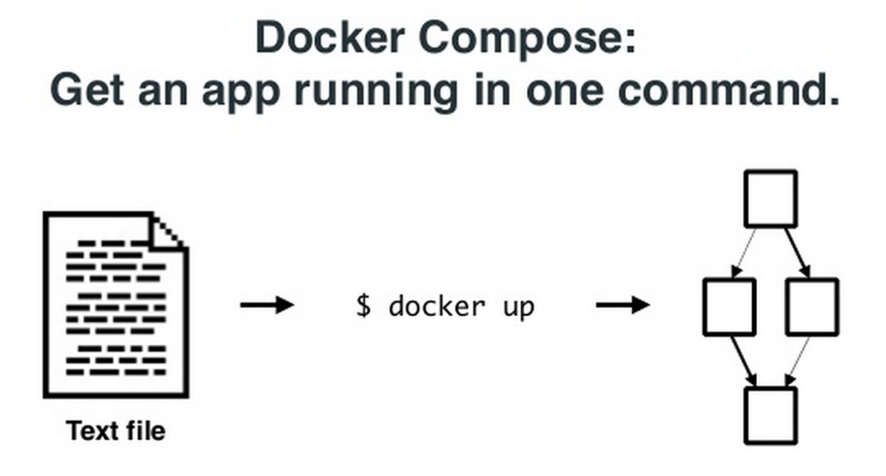
Docker Compose

Slide 23
Docker Compose Demo
Install docker compose
Create a compose file docker-compose.yml docker-compose up
check containers created check server up

Slide 24
Docker Swarm
Docker Swarm provides native clustering to Docker.
It turns a pool of Docker hosts into a single, virtual Docker host.
Docker Swarm solves one of the fundamental limitations of Docker where the containers could only run on a single Docker host.

Slide 25
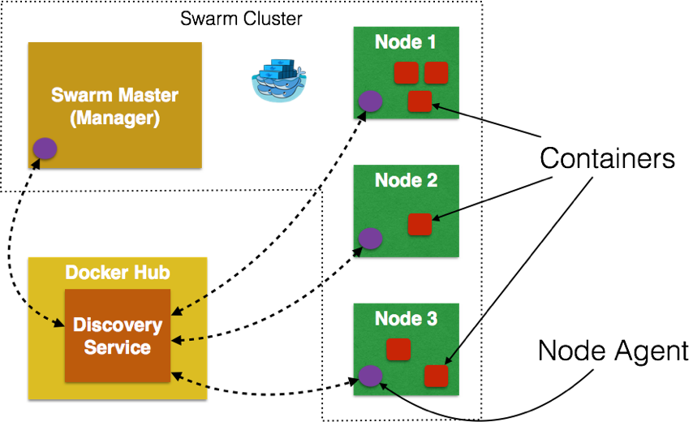
Docker Swarm Components
like consul, zookeeper and etcd.

Slide 26
Swarm Scheduling Strategies
The Docker Swarm scheduler features multiple strategies for ranking nodes. The strategy you choose determines how Swarm computes ranking.
spread: Swarm optimizes for the node with the least number of running containers
binpack: The binpack strategy causes Swarm to optimize for the node which is most packed.
random: The random strategy, like it sounds, chooses nodes at random regardless of their available CPU or RAM.

Slide 27
Docker Swarm Demo
Create Swarm manager
Create Swarm nodes
Join swarm nodes with Swarm manager Create containers using swarm manager Run the application

Slide 28













Docker Compose: Multi Container Applications
Without Compose
Build and run one container at a time
Manually connect containers together
Must be careful with dependencies and start up order
With Compose
Define multi container app in compose.yml file
Single command to deploy entire app
Handles container dependencies
Works with Docker Swarm, Networking, Volumes, Universal Control Plane
4

Slide 29


Docker Compose: WordPress Application
Without Compose
With Compose
$docker run -e MYSQL_ROOT_PASSWORD=<pass> -e MYSQL_DATABASE=wordpress --name wordpressdb -v "$PWD/database":/var/lib/mysql -d mysql:latest
services:
db:
image: mysql:5.7 volumes:
- db_data:/var/lib/mysql environment: MYSQL_ROOT_PASSWORD:
MYSQL_DATABASE: wordpress wordpress:
depends_on:
- db
image: wordpress:latest ports:
- "80:80"
environment: WORDPRESS_DB_PASSWORD=<pass>
$docker run -e WORDPRESS_DB_PASSWORD=<pass> --name wordpress --link wordpressdb:mysql -p 80:80 -v "$PWD/html":/var/www/html
-d wordpress
5

Slide 30

What is Docker Compose?
A tool for defining and running multi- container Docker applications
With Compose, you use a YAML file to configure your application’s services.
Compose works in all environments: production, staging, development, testing, as well as CI workflows.
With a single command, you create and start all the services from your configuration

Slide 31

3 step process of Docker Compose

Slide 32

Docker Compose is a 3 Steps Process
Define your app’s environment with a Dockerfile
Define the services that make up your app in Docker Compose file
Run the CLI:
$ docker-compose up

Slide 33
Building Blocks of Docker Compose

Slide 34


Building Blocks of Docker Compose
A
B
C
Services
Volumes
Networking

Slide 35


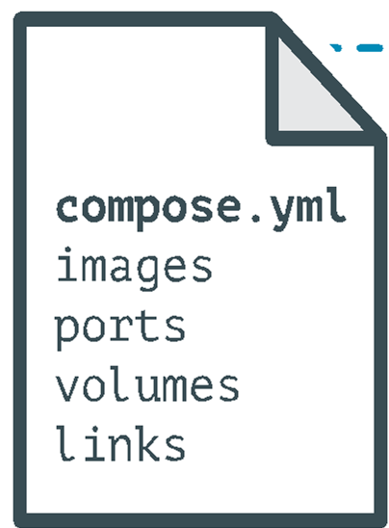
Docker Compose: Multi Container Applications
containers:
web:
build: .
command: python app.py ports:
- "5000:5000"
volumes:
.:/code environment:
PYTHONUNBUFFERED=1
redis:
image: redis:latest
command: redis-server --appendonly yes

Slide 36
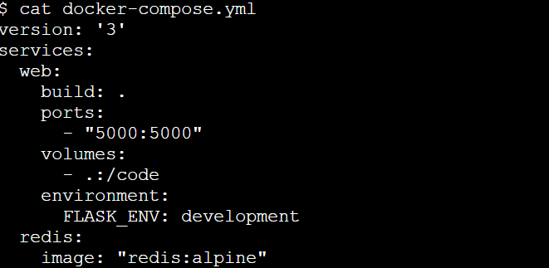
A Sample Docker Compose File

Slide 37
Docker Compose Compatibility Matrix

Slide 38
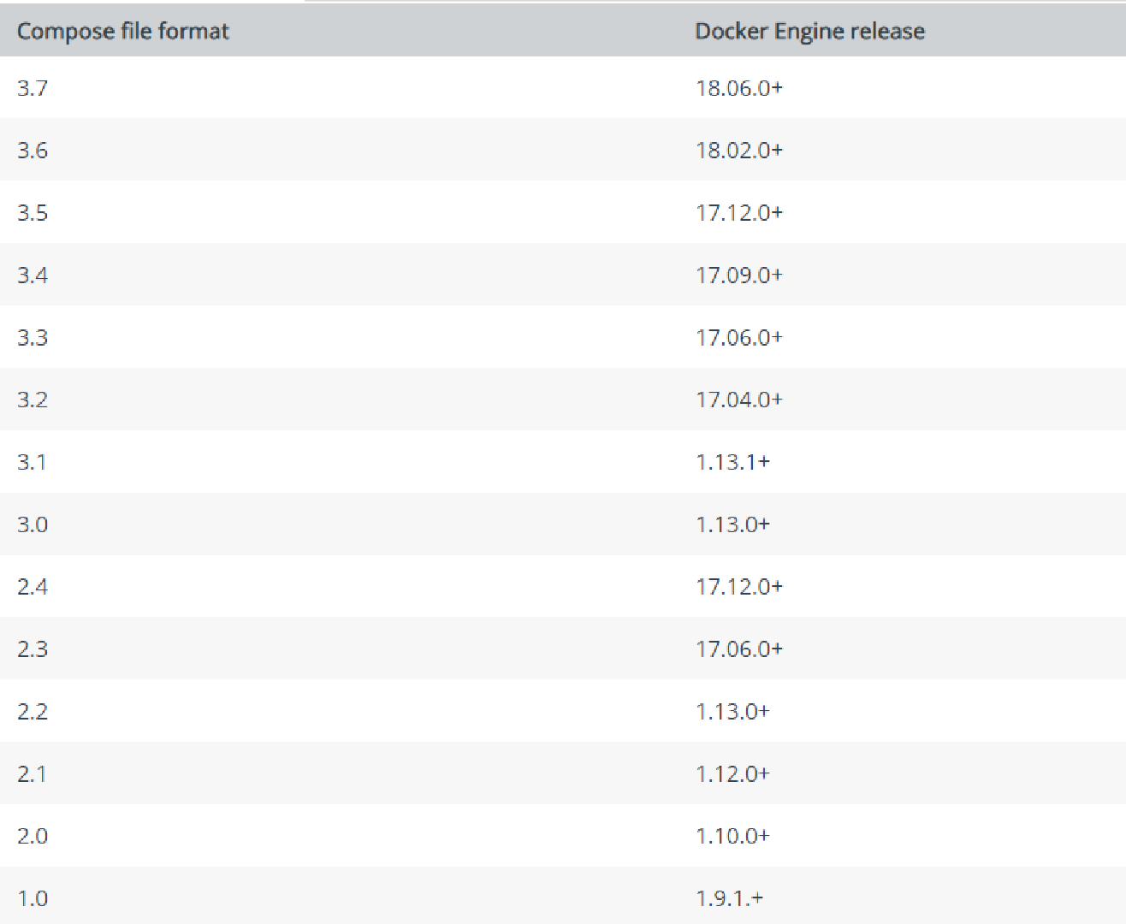
Docker Compose File Format Compatibility Matrix

Slide 39
Environmental Variable in Docker Compose

Slide 40
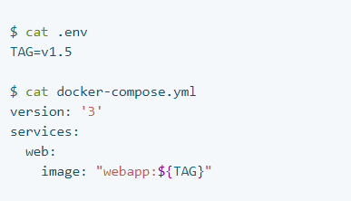
Environmental Variable in Docker Compose:
Using .env file

Slide 41
Environmental Variable in Docker Compose:
Using `docker-compose run` command

Slide 42
Networking in Compose

Slide 43
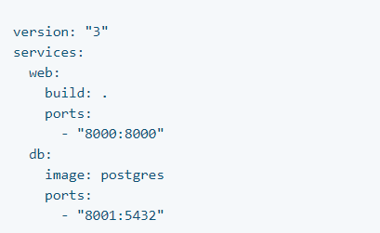
Networking in Compose
A network called myapp_default is created.
A container is created using web’s configuration.
It joins the network myapp_default under the
name web.
A container is created using db’s configuration. It
joins the network myapp_default under the
name db.

Slide 44
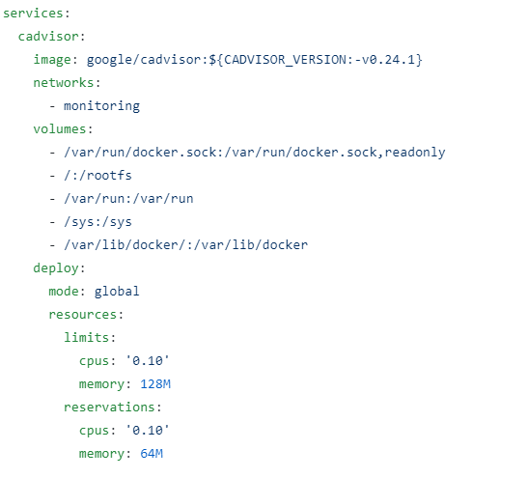
Compose for Swarm Mode
The same Compose file can be used to deploy
containerized apps on multi-host system
The overlay driver creates a named network
across multiple nodes in a swarm.
The “global mode” enable atleast one copy of
apps running on every node of the swarm

Slide 45
How to install Docker Compose?

Slide 46
How to Install Docker Compose
$ curl -L https://github.com/docker/compose/releases/download/1.25.0/docker-compose-
`uname -s`-`uname -m` -o /usr/local/bin/docker-compose
$ chmod +x /usr/local/bin/docker-compose
Note: Docker Desktop will automatically install the latest version of Docker Engine for you.

Slide 47
A Sample WordPress Compose File

Slide 49
Playground:
https://play-with-docker.com
Labs:
https://dockerlabs.collabnix.com/intermediate/workshop

Slide 50
https://github.com/docker/compose/

